Slide 1
Accurate machine learning based CRF prediction
Yangfan Sun, Mouqing Jin, Li Li, and Zhu Li
Dept of Computer Science & Electrical Engineering
University of Missouri, Kansas City
01/24/2018

Slide 2
Outline
Motivation and objective
Content-dependent model selection
Machine learning based model parameter fitting
Conclusion and future work

Slide 3
Outline
Motivation and objective
Content-dependent model selection
Machine learning based model parameter fitting
Conclusion and future work

Slide 4
Motivation
Compared with the coding framework using QP as input, using the constant rate factor (CRF) as input can obviously improve the coding performance

Slide 5
Motivation
However, the CRF is without an obvious relationship with the bitrate compared with the QP
Lots of rate control researches build the relationship between bitrate and QP [1][2]
Only a few researches try to build a relationship between bitrate and CRF [3]
A possible solution is to use multi-pass transcoding to approximate the target bitrate as much as possible
Such a scheme may significantly increase the complexity
[1] S. Ma, Wen Gao and Yan Lu, "Rate-distortion analysis for H.264/AVC video coding and its application to rate control," in IEEE Transactions on Circuits and Systems for Video Technology, vol. 15, no. 12, pp. 1533-1544, Dec. 2005.
[2] B. Li, H. Li, L. Li and J. Zhang, " $\lambda $ Domain Rate Control Algorithm for High Efficiency Video Coding," in IEEE Transactions on Image Processing, vol. 23, no. 9, pp. 3841-3854, Sept. 2014.
[3] M. Covell, M. Arjovsky, Y. Lin and A. Kokaram, "Optimizing Transcoder Quality Targets Using a Neural Network with an Embedded Bitrate Model." Electronic Imaging 2016.2 (2016): 1-7.

Slide 6
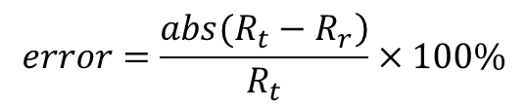
Objective
Our objective in this project is to find a robust content-dependent relationship between the bitrate and CRF to avoid multi-pass encoding.
The accuracy of the model will be measured by the bitrate error between the real bitrate R_{r} obtained on our machine learning based model and the target bitrate R_{t}
Our project target
The percentage of the bitrate error within 20% will be above 90%
The percentage of the bitrate error within 10% will be above 70%
$$error=\frac{\left.abs(R_{t}−R_{r}\right)}{R_{t}}×100\%$$

Slide 7
Overall scheme of the proposed framework
We intend to achieve the target using a two-pass coding scheme
In the first pass, deriving the model using the features from the one-pass coding and the network (from the training process)
In the second pass, using the model and target bitrate to derive the CRF for coding

Slide 8
Outline
Motivation and objective
Content-dependent model selection
Machine learning based model parameter fitting
Conclusion and future work

Slide 9
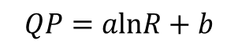
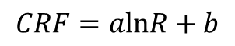
Linear model
Motivated by our previous research, the QP is with a linear relationship with bitrate
Motivated by Google’s paper, the CRF is also with a linear relationship with bitrate
All these models are linear models in essence
Therefore, we try the following model first
$$QP=alnR+b$$
$$logR\left(c,t,h,v\right)=logK(v)−a(v)c+b(v)logt+d(v)logh$$
$$CRF=alnR+b$$

Slide 10
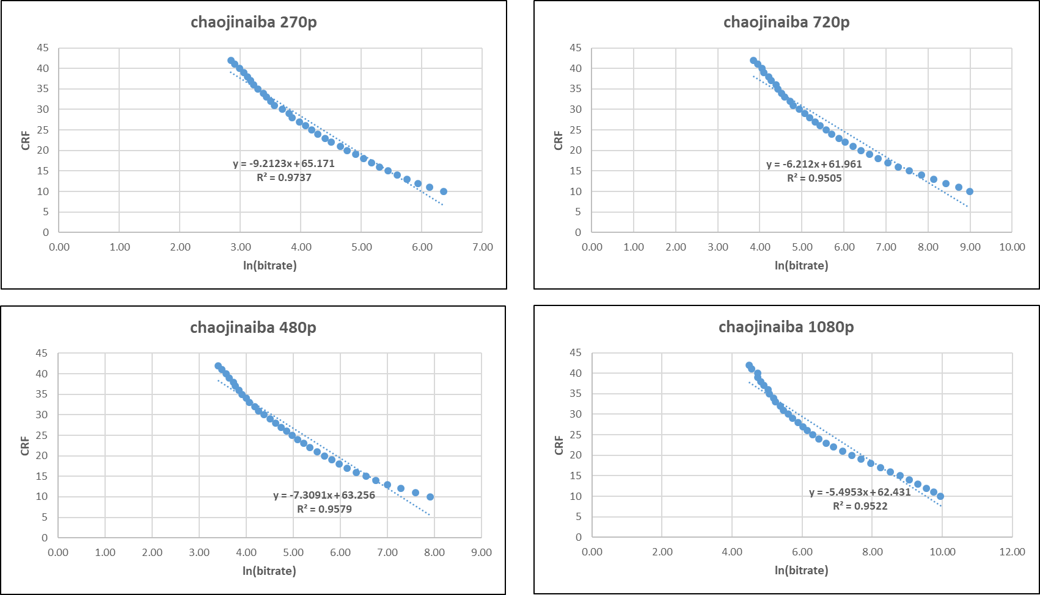
Some observations of the linear model
The following figure shows the linear model is not accurate

Slide 11
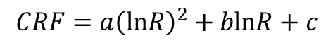
Second-order model
Motivated by the observation that the QP is with the second-order model with the bitrate if a wide variety of QPs are needed to be covered
In our project, we adopt the second-order model to describe the relationship instead of the linear model. We also observe an obvious improvement of bitrate accuracy
$$CRF=a{\left(lnR\right)}^{2}+blnR+c$$

Slide 12
Accuracy comparison of the two models
Below we show the bitrate error within 10% and 20% on 2nd order model, testing on 720 5-sec sequences
 | Bitrate error within 20% | Improve on linear model | Bitrate error within 10% | Improve on linear model
270p | 100% | 98% (2%) | 99% | 87% (12%)
480p | 100% | 96% (4%) | 99% | 80% (19%)
720p | 99% | 89% (10%) | 97% | 62% (35%)
1080p | 97% | 82% (15%) | 89% | 49% (40%)
Avg | 99% | 91 (8%) | 96% | 69% (27%)

Slide 13
Outline
Motivation and objective
Content-dependent model selection
Machine learning based model parameter fitting
Conclusion and future work

Slide 14
Machine learning based model parameter fitting
We extracted the following features from video segment and obtained content-dependent parameters with the second order model, as features and labels of machine learning based model.
Features:
There’s totally 13 features extracted from 5 sec sequences we adopted, including:
Average PSNR on each sequence
Bitrate on each sequence
Percentage of bits for texture on I macroblock (MB) on each sequence
Percentage of bits for texture on P MB on each sequence
Percentage of bits for texture on all MBs on each sequence
Average number of bits for texture on I MB on each sequence
Average number of bits for texture on P MB on each sequence
Average number of bits for texture on all MBs on each sequence
Percentage of I MB on each sequence
Percentage of P MB on each sequence
Percentage of zero motion vector difference on each sequence
Average of motion vector on each sequence
Average number of bits for motion vector on each sequence
Labels:
3 content-dependent parameters used in the model equation.

Slide 15
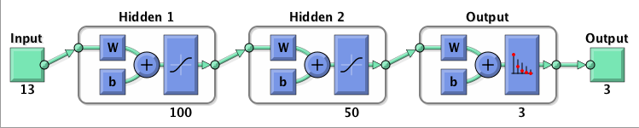
Network structure
Hyper-parameters
Preprocess: MinmaxScaler for features, StandardScaler for labels
Activation function: tf.nn.tanh
Learning rate: 0.05
Optimizer: Gradient descent optimizer
Network Structure
Two hidden layers

Slide 16
Training data derivation
We adopt 4,780 5-sec sequences as our training dataset, and use another 720 5-sec sequences to evaluate our training result.
Training set (80%) | Validation set (20%) | Testing set
3,824 samples from 4,780 dataset, each samples only pick one CRF value situation (CRF=28), to predict all CRF value situation | 956 samples from 4,780 dataset, each samples only pick one CRF value situation (CRF=28), to predict all CRF value situation | 720 samples from 720 dataset, each samples only pick one CRF value situation (CRF=28), to predict all CRF value situation

Slide 17
Simulation results
The average results for all the resolutions
The average percentage of test points within 20% is 89.5%
The average percentage of test points within 10% is 69.0%
 | Iteration | 20% | 10% | 20% | 10% | 20% | 10%
 |  | Training set |  | Validation set |  | Test set
270p | 53,000 | 93% | 73% | 88% | 68% | 91% | 71%
480p | 12,0000 | 94% | 78% | 92% | 74% | 92% | 73%
720p | 71,000 | 91% | 74% | 88% | 69% | 90% | 70%
1080p | 57,000 | 88% | 69% | 84% | 63% | 85% | 62 %
Ave |  | 91.5% | 73.5% | 88.0% | 68.5% | 89.5% | 69.0%

Slide 18
Outline
Motivation and objective
Content-dependent model selection
Machine learning based model parameter fitting
Conclusion and future work

Slide 19
Conclusion
We presented 2nd order model to simulate the relationship between bitrate and CRF on each 5-sec sequence. There is an obvious improvement compared with previous linear model, averagely improving 7.8% on bitrate error within 20% and 27% on bitrate error within 10%.
In the mean time, we generated 3,267 5-sec sequences for future training and testing. The sequences are obtained from Youtube. We go through the decoding, down sampling, and encoding to obtain the features.
The simulation results on our machine learning based network generally reach the goals, averagely the bitrate error within 20% is 89.5% and within 10% is 69.0%.

Slide 20
Future work
From the current experimental results, we can still observe some differences between the label and the test results.
We consider that we can further improve the performance in the following two ways.
Feature enhancement
Pooling: We now only choose sequence level features, we can have block features or region based features in the future. The region based feature may use pooling from the block features
Decode Buffer: We now only choose features from the bitstream, if we can have access to the reconstructed videos, we can derive some pixel level features such as FSIG
Network structure
CNN: If we can use block features or region based features, we can further enroll CNN into our network structure
Implement the python code into C++

Slide 21
Thank you!

